Slide 1
EXECUTIVE BUSINESS PRESENTATION
Istanbul Malls Customer Segmentation Analysis
Strategic Multi-Dimensional Performance Evaluation Across 10 Shopping Malls (2021–2023)
Prepared for: Executive Leadership & Mall Operations | Author: Senior Data & Analytics Specialist

Slide 2
SECTION 1 — DATA ENGINEERING & MODELING
Project Infrastructure & Data Pipeline
SQL DATA EXTRACTION
Database & Scale
• Extracted 99,457 transaction records from remote relational DB (project_customer_segmentation).
• Zero missing values across critical fields: invoice, customer_id, age, gender, category, mall.
• Full 3-year multi-mall longitudinal scope (2021–2023).
DATA AUGMENTATION
DAX Row Calculations
• Total_Revenue = [price] * [quantity]: Created line-item row value for precise financial aggregation.
• Age_Group = SWITCH(TRUE(), age < 30, 'Youth', age <= 50, 'Adults', 'Seniors'): Demographic taxonomy.
• Resolved measures vs. calculated column conflicts.
VISUAL ANALYTICS
Power BI Dashboards
• Page 1: Customer Demographics & Financial Revenue Overview.
• Page 2: Product Category Performance & Payment Behavior Channels.
• Interactive cross-filtering across 10 Istanbul malls.

Slide 3
SECTION 2 — FINDINGS BREAKDOWN (TASKS 1–10)
Core Analytical Findings & Empirical Insights
FEMALE MARKET SHARE
59.8%
59.48K Orders / 150.2M TL Revenue
Females dominate volume and revenue with equal average transaction value (~2,525 TL).
PRIMARY REVENUE DRIVER
30–50 Age
105.5M TL Total Revenue
Adult demographic holds highest purchasing power, followed by Seniors 50+ (~91.2M TL).
TOP PRODUCT CATEGORY
Clothing
113.8M TL Category Sales
Clothing and Shoes (~66.1M TL) represent the primary merchandise drivers across all 10 malls.
DOMINANT PAYMENT CHANNELS
Cash & Card
44.7% Cash / 35.1% Credit Card
Cash leads overall volume; Credit Cards spike significantly for high-value Tech & Footwear.

Slide 4
SECTION 3 — VISUAL ANALYTICS & REPORTING
Power BI Executive Dashboard Structure
Page 1: Demographics & Revenue Overview
• Task 1: Gender Distribution (Donut Chart) — 59.8% Female / 40.2% Male.
• Task 2 & 3: Quantity & Total Revenue by Gender (Clustered Column Chart).
• Task 5, 6 & 7: Invoice Count, Product Volume & Revenue by Age Group (Youth, Adults, Seniors).
[Insert Dashboard Page Screenshot Here]
Page 2: Category Performance & Payment Behavior
• Task 4 & 8: Category Distribution by Gender & Age Group (Stacked Column Chart).
• Task 9: Category Revenue relative to Payment Method Channels.
• Task 10: Overall Payment Method Distribution (44.7% Cash, 35.1% Credit Card, 20.2% Debit Card).
[Insert Dashboard Page Screenshot Here]

Slide 5
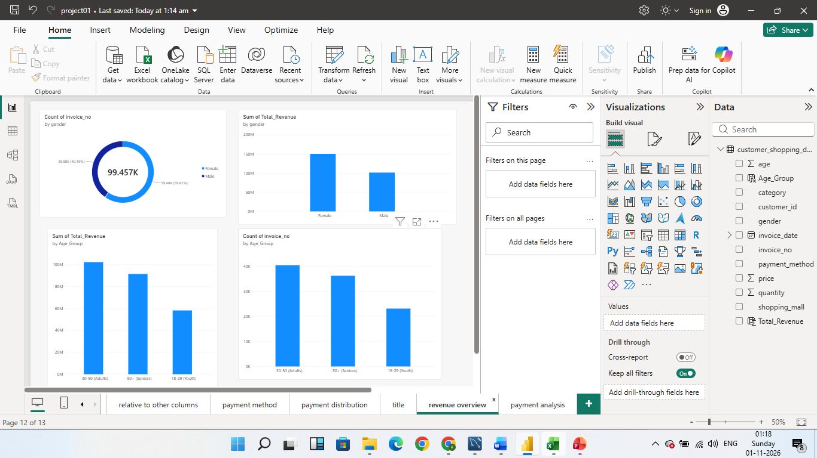

Slide 6
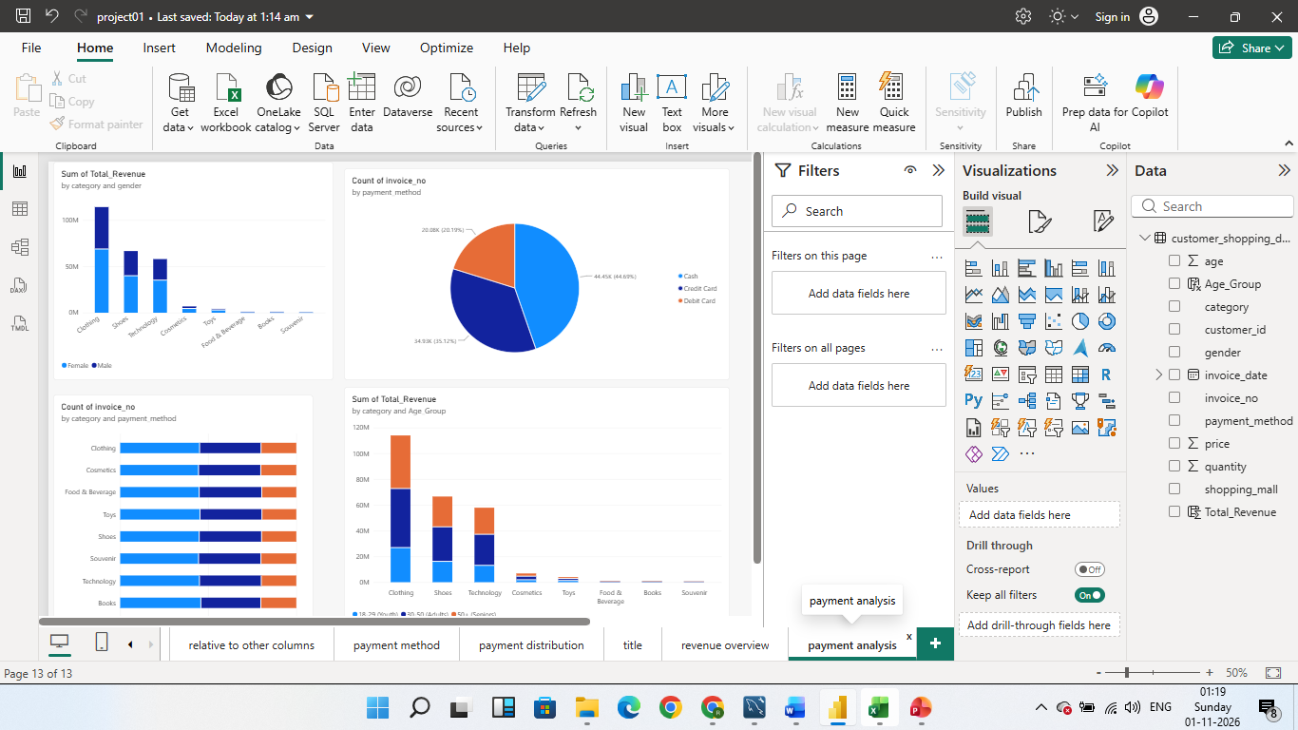

Slide 7
SECTION 4 — MANAGEMENT RECOMMENDATIONS
Actionable Business Inputs & Strategic Recommendations
1. Targeted Female VIP & Loyalty Rewards
Female shoppers generate 60% of total revenue (~150M TL). Launch dedicated VIP loyalty perks and early-access promotions around Clothing and Cosmetics in top malls (Mall of Istanbul, Kanyon).
2. Adult Demographic Marketing (30–50)
Direct 45%–50% of promotional budgets toward the 30–50 age group. Focus on family bundles and seasonal apparel refreshes to capitalize on their high purchasing power.
3. High-Ticket Banking Installment Plans
Partner with major Turkish banks to introduce 0% interest credit card installment offers for high-ticket items (Technology & Shoes) to increase average basket size.
4. Dynamic Mall Inventory Allocation
Ensure stock optimization for fast-moving categories (Clothing & Shoes) in high-traffic malls to eliminate stockouts during weekend peak retail hours.

Slide 8
CONCLUSION & PROJECT DELIVERABLES
Project Summary & Execution Roadmap
✅ Relational SQL Database: 99,457 validated transaction records connected and modeled.
✅ Power BI Dashboard: Interactive 2-page report active and fully functional.
✅ Formal Business Report: Istanbul_Malls_Customer_Segmentation_Report.docx completed.
✅ PowerPoint Presentation: Executive slide deck ready for stakeholder presentation.

